Slide 1
CS-661 Python Deep Learning Project
Aakash Akhilesh Patel

Slide 2
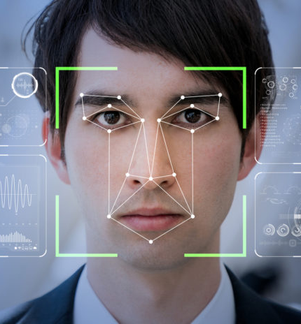
What are we solving?
The "Music Recommendation System Using Emotion Detection with Convolutional Neural Network" addresses the challenge of personalizing music recommendations based on users' emotional states. Traditional music recommendation systems often lack the ability to capture users' current emotions, resulting in less relevant suggestions. Our project aims to bridge this gap by employing Convolutional Neural Networks to analyze facial expressions and detect emotions in real-time. By understanding users' emotional states, we provide a more nuanced and emotionally resonant music recommendation experience, enhancing user satisfaction and engagement with their music listening journey.

Slide 3

Why are we solving?
Fitness and Workout Apps:
Integrate the emotion detection system with fitness or workout applications to recommend music that aligns with the user's emotional state during different phases of exercise. Energetic music for high-intensity intervals and calming tunes for cooldown sessions can enhance the overall workout experience.
Stress Reduction in Office Environments:
Implement the system in office environments to help employees manage stress. Based on detected emotions, the system can recommend soothing music during breaks or work hours to create a more relaxed atmosphere and improve mental well-being.
Therapeutic and Wellness Applications:
Integrate the emotion-based music recommendation system into therapeutic applications for mental health. It can be used to recommend calming music for relaxation, uplifting tunes for mood enhancement, or personalized playlists for stress relief.

Slide 4
Some more use cases in today’s world on its need
Public Transportation Commuters:
Assist commuters during their daily journeys on public transportation by recommending music that matches their emotional state. This can provide a more pleasant commuting experience and serve as a form of entertainment and stress relief.
Retail and Shopping Experiences:
Enhance the shopping experience by incorporating the emotion detection system into retail environments. Tailor background music in stores based on customers' emotions to create a positive and enjoyable atmosphere, potentially influencing purchasing behavior.
Healthcare Settings:
Utilize the system in healthcare settings such as hospitals and clinics to provide personalized music recommendations for patients based on their emotional needs. This can contribute to a more comfortable and soothing environment, especially in waiting areas or recovery rooms.
Educational Platforms:
Integrate the system into educational platforms to enhance the learning experience. Recommend background music that aligns with the emotional state conducive to focused studying, relaxation during breaks, or motivation during challenging tasks.

Slide 5
What are we expecting?
Envisage
Envisage dynamic adjustments to playlists based on users' changing emotions, ensuring a continuous alignment between the music and their evolving feelings.
Aim
Aim for recommendations that align with users' moods, fostering a stronger emotional connection to the suggested music.
Expect
Expect increased user satisfaction through a more responsive and emotionally attuned music recommendation system, enhancing overall user experience.
Envision
Envision the system's ability to adapt quickly to users' shifting emotions, providing timely and relevant music suggestions in response to changing states.
Anticipate
Anticipate higher user engagement as the system tailors music suggestions to users' current emotional states, creating a more immersive and enjoyable listening experience.

Slide 6

About Dataset?
Emotion Categories: FER 2013 consists of grayscale images of 48x48 pixels, each labeled with one of seven different emotion categories:
[anger, disgust, fear, happiness, sadness, surprise, and neutral]
Dataset Link: https://www.kaggle.com/datasets/msambare/fer2013
These emotions represent common facial expressions.
Data Size: The dataset contains over 35,000 images, which are divided into training and testing sets. There are 28,709 images in the training set and 3,589 images in the testing set.
Image Quality: The images are relatively low in resolution (48x48 pixels), and they are grayscale. This simplicity in image format allows for efficient processing and training, making it suitable for research and educational purposes.
Kaggle Datasets:
Kaggle hosts various music-related datasets that you can explore, such as the Song Attributes dataset, which includes audio features for thousands of tracks.

Slide 7
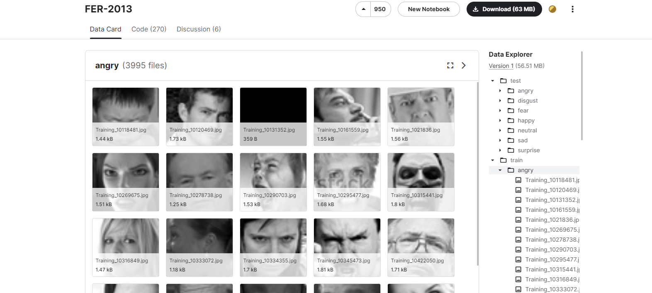

Slide 8

Challenges in our Dataset
The dataset has its limitations, including the potential presence of noisy or ambiguous labels, variations in lighting conditions, and differences in image quality.
Had to clean up the data using Exploratory Data Analysis and Principal Component Analysis which omitted duplicate values and filled missing values in our data
Popularity Bias: Music Dataset may be influenced by the popularity of tracks, potentially leading to recommendation bias towards well-known songs.

Slide 9

Let’s know talk about our CNN Model

Slide 10
Input Layer:
Utilizes a Conv2D layer with a kernel size of (3, 3) and ReLU activation.
Input shape is set to (48, 48, 1), indicating grayscale images of size 48x48 pixels.
Convolutional Blocks:
Includes three convolutional blocks with increasing filter sizes (32, 64, 128, 256).
Uses 'same' padding to maintain spatial dimensions.
Applies Batch Normalization for stable training.
Employs MaxPooling (2x2) to downsample feature maps.
Introduces Dropout (0.2) for regularization, reducing overfitting.
Regularization:
Applies L2 regularization (0.01) to the third and fourth convolutional layers.
Helps prevent overfitting by penalizing large weights in the model.
Flatten Layer:
Flattens the output from convolutional layers into a 1D vector.
Prepares the data for the subsequent fully connected layers.
Fully Connected Layers:
Consists of a dense layer with 512 neurons and ReLU activation.
Incorporates Dropout (0.2) for regularization.

Slide 11
Output Layer:
Final layer with 7 neurons (softmax activation) representing different facial expression classes.
Uses softmax activation for multi-class classification.
Model Compilation:
Compiles the model using the Adam optimizer.
Utilizes categorical crossentropy as the loss function for multi-class classification.
Monitors accuracy as the evaluation metric.
Summary:
The model is summarized, showing the architecture, layer types, output shapes, and parameters.

Slide 12
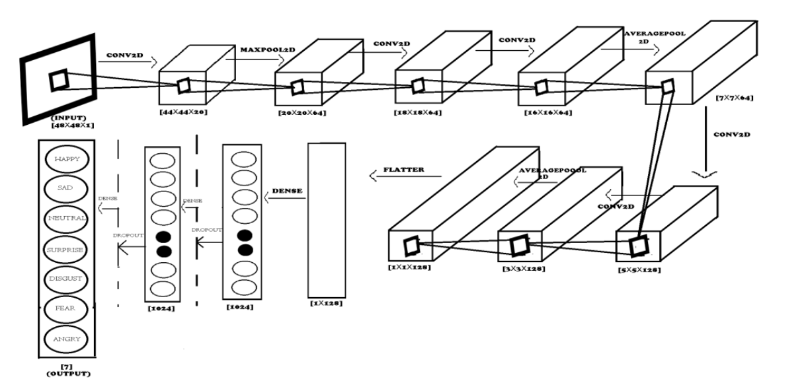
CNN Approach used

Slide 13
Detailed Plan of Project
Data Preprocessing: steps for the FER 2013 dataset:
(Resizing images, Converting images to grayscale, Normalizing pixel values)
Model: 1 CNN Architecture and Model Training
Emotion Detection Results
Model: 2 Time Tracking Model which will track each and every emotion for every second in the live footage
Integration of Emotion Detection Results and Time tracking model result with Music Database.
It will generate result file in the form of audio as a final output in the end.

Slide 14
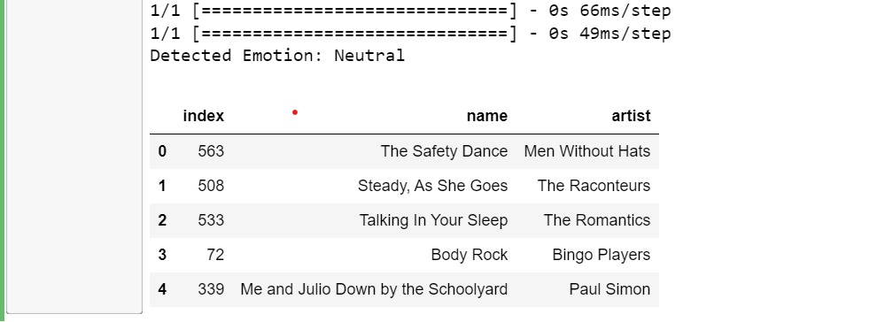

Slide 15
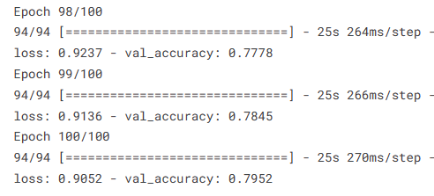
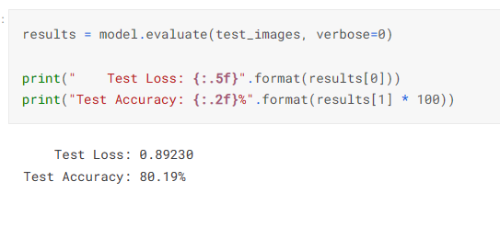
Results For Our Project:

Slide 16
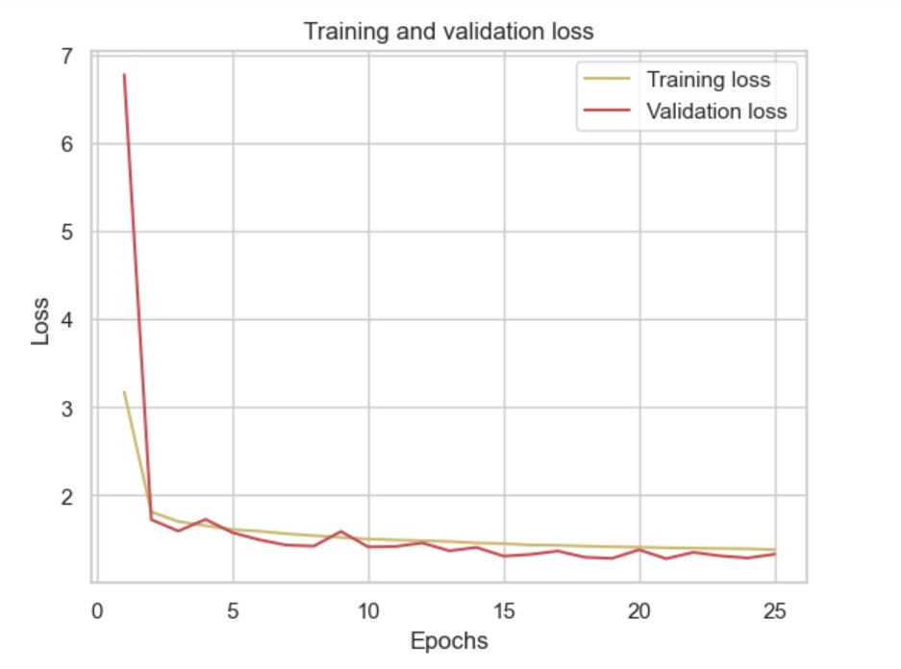
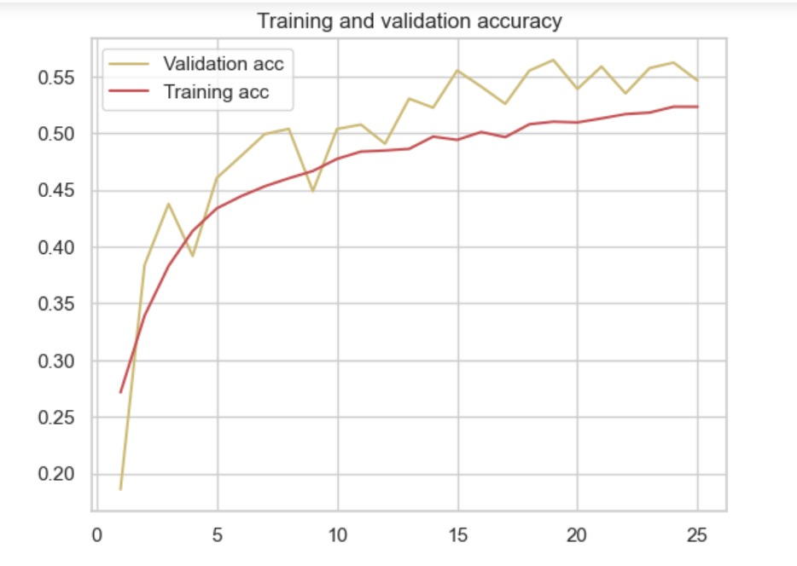
Visualizing the Model

Slide 17

Conclusion
In conclusion, the Music Recommendation System employing Emotion Detection with Convolutional Neural Networks represents a significant stride in personalized music experiences. By leveraging deep learning, the model accurately captures and interprets user emotions, providing tailored music suggestions. The seamless integration of emotion analysis enhances user engagement, creating a dynamic and emotionally resonant music selection. This project not only showcases the potential of convolutional neural networks in emotion recognition but also underscores the importance of incorporating emotional intelligence into technology for a more immersive and satisfying user journey in the realm of music recommendations.

Slide 18
Future Directions
Incorporate additional modalities, such as lyrics sentiment analysis or audio signal processing, to provide a more comprehensive understanding of emotions in music. Multi-modal analysis can enhance the system's accuracy and robustness.
Collaborate with mental health professionals to curate mood-specific playlists that can support users in managing stress, anxiety, or other mental health challenges. Explore partnerships with mental health apps for broader accessibility.
Develop educational features that help users explore the emotional aspects of music. This could include insights into music theory, cultural influences on emotions in music, or historical context to enhance users' understanding and appreciation of diverse musical expressions.
Develop a mechanism to gather user feedback on the accuracy of emotion predictions. Implement a feedback loop to continuously improve the model by learning from user preferences and adjustments to the recommended music.
Enhance the recommendation system by incorporating user-specific preferences and considering the context in which the music is being listened to. Factors such as time of day, location, and recent user activities can influence emotional states.

Slide 19
Reference
https://innovate.ieee.org/innovation-spotlight/facial-expression-recognition/
https://www.kaggle.com/datasets/msambare/fer2013
[1] Yu, L., Li, B. and Jiao, B., (2019). Research and Implementation of CNN Based on TensorFlow. IOP Conference Series: Materials Science and Engineering, 490, p.042022. Available at: https://iopscience.iop.org/article/10.1088/1757-899X/490/4/042022
[2] Ertam, F. and Aydin, G., (2017). Data classification with deep learning using Tensorflow. 2017 International Conference on Computer Science and Engineering (UBMK), Available at: https://ieeexplore.ieee.org/document/8093521
[3] Shiddieqy, H., Hariadi, F. and Adiono, T., (2017). Implementation of deep-learning-based image classification on single board computer. 2017 International Symposium on Electronics and Smart Devices (ISESD), [online] https://ieeexplore.ieee.org/document/8253319.

Slide 20

Thank You

